Slide 1
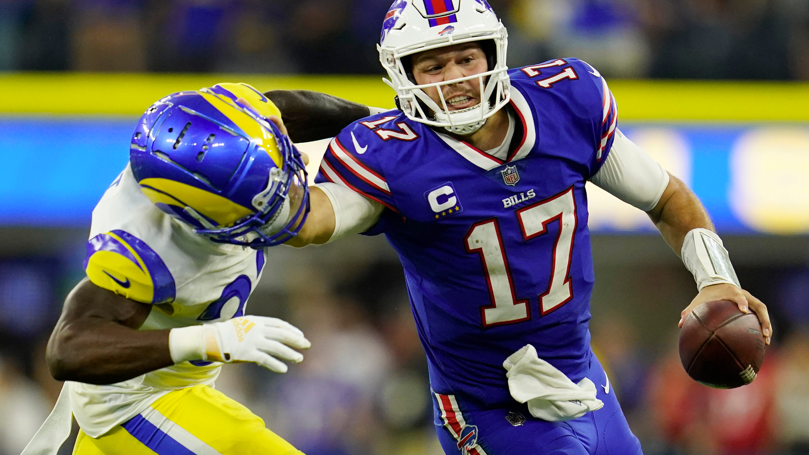

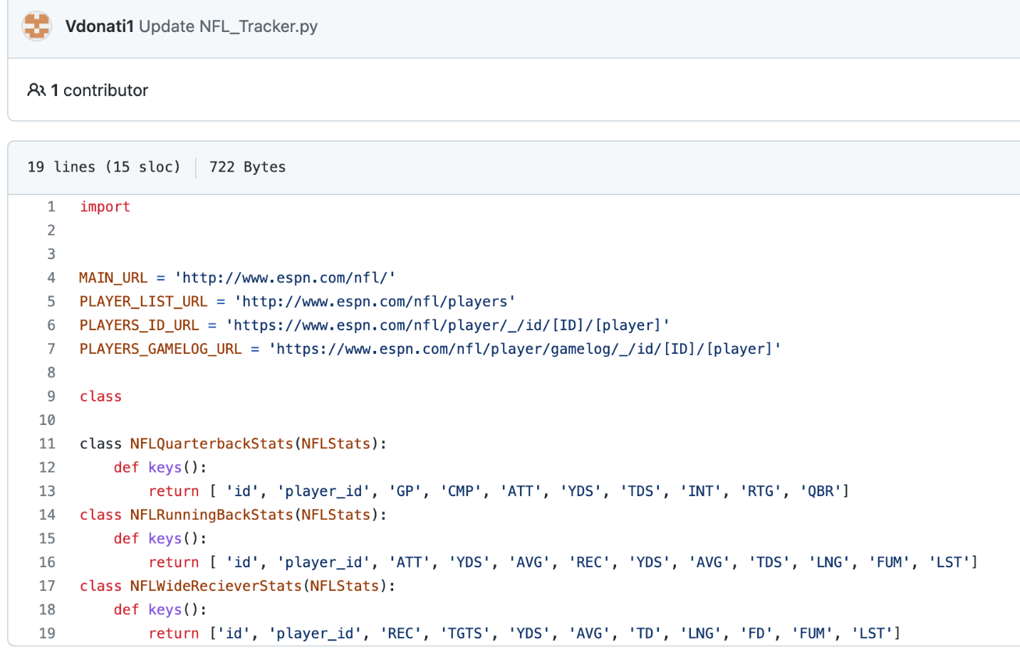
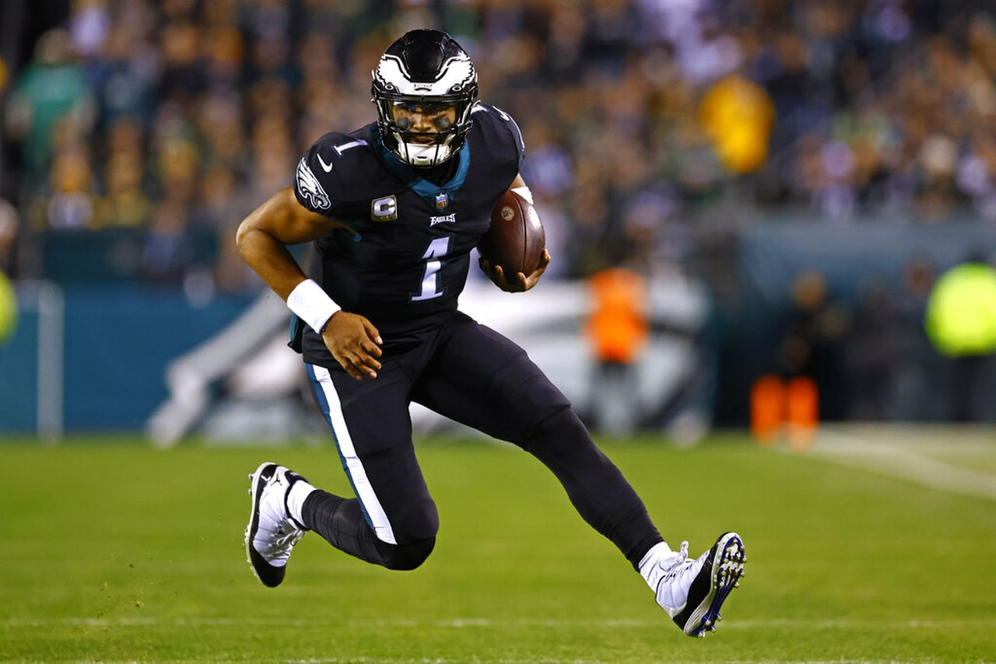
NFL-Stat Tracker
By: Vinny Donati
Coding software that keeps track of NFL stats throughout the season of every player
Repository link: https://github.com/ksu-is/NFL-Tracker

